Slide 1


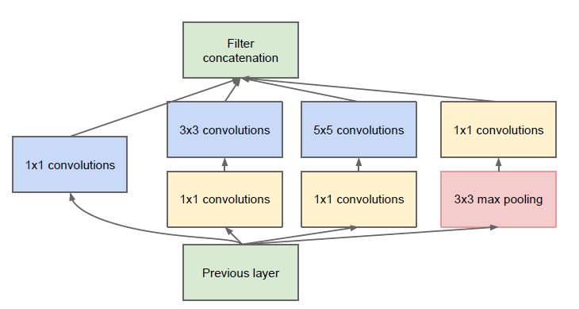
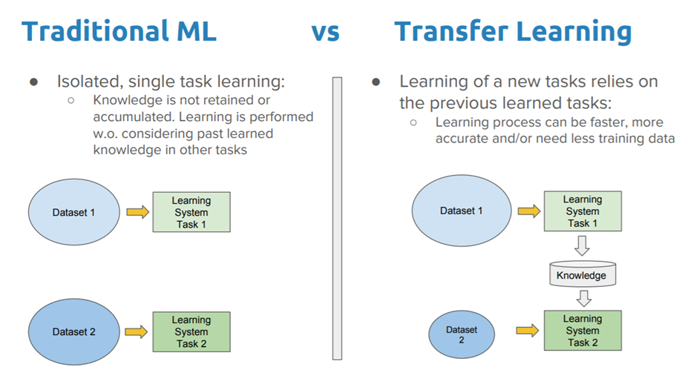
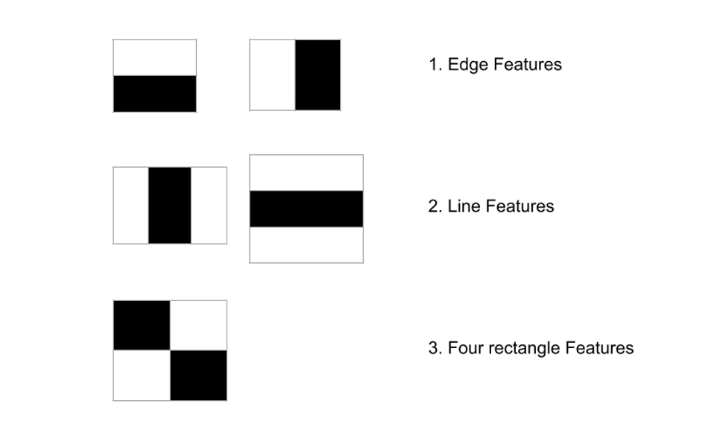
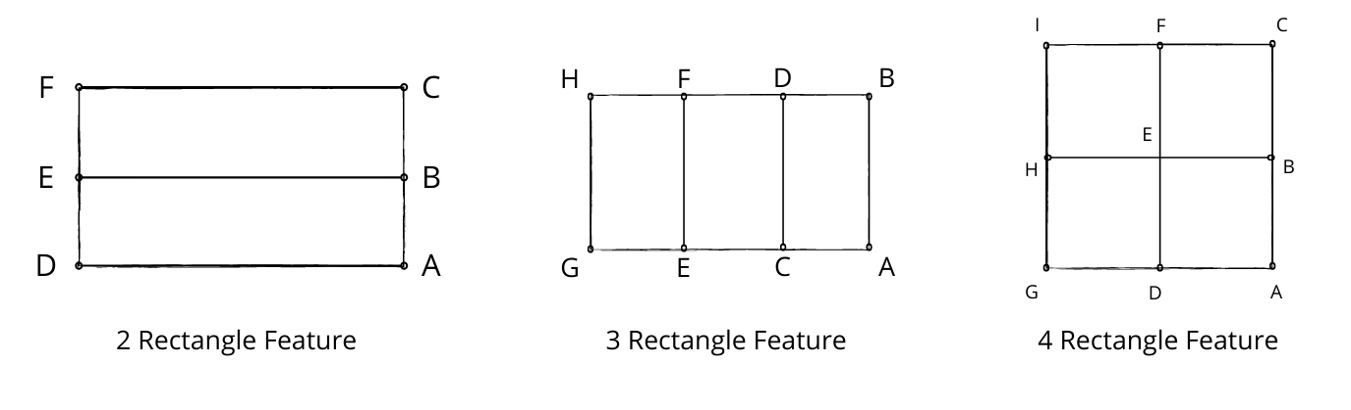
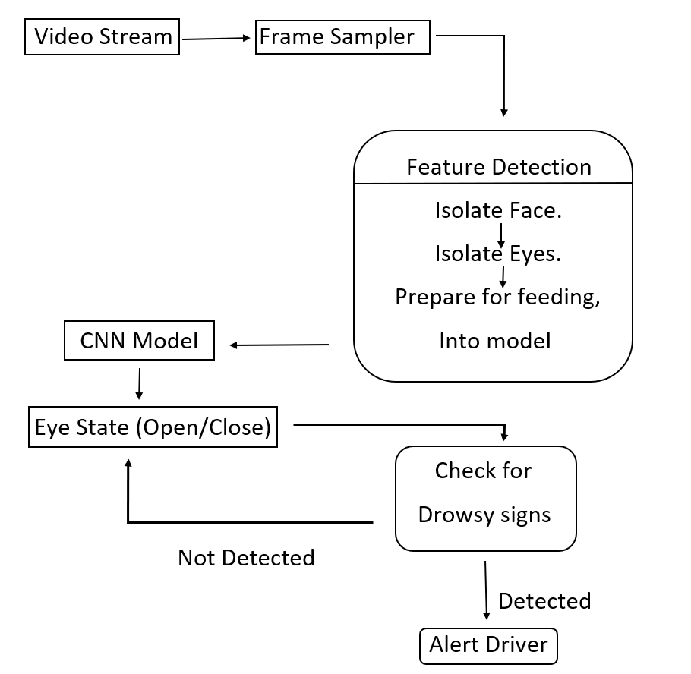
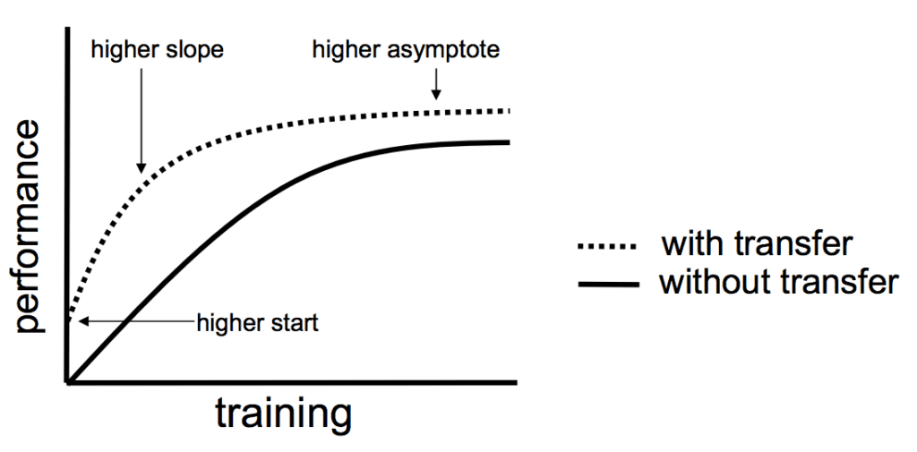
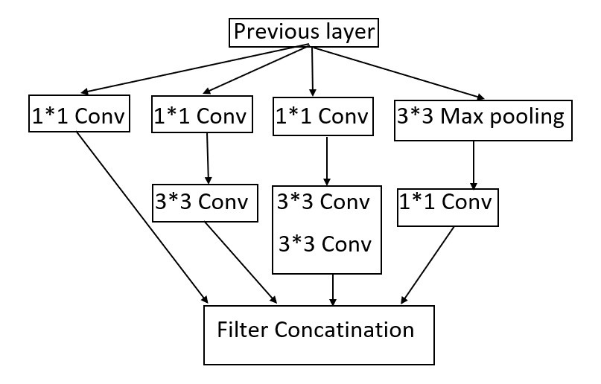
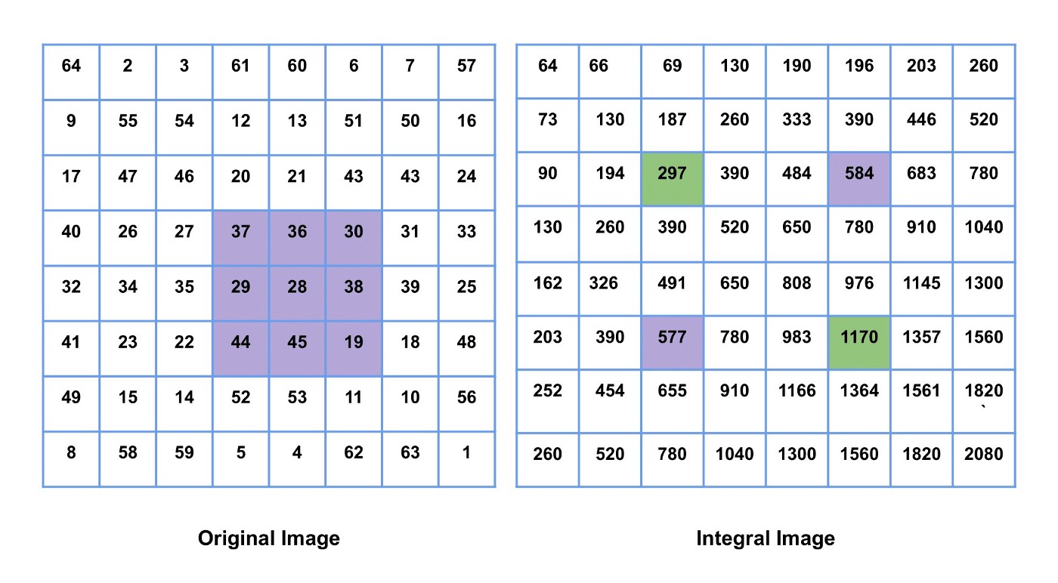
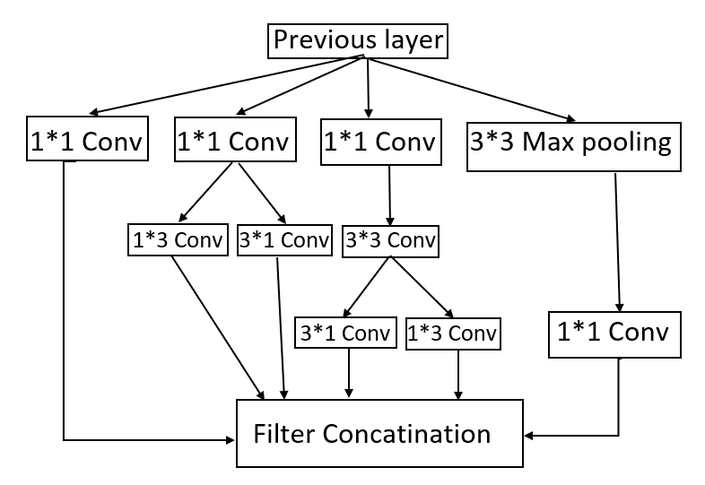
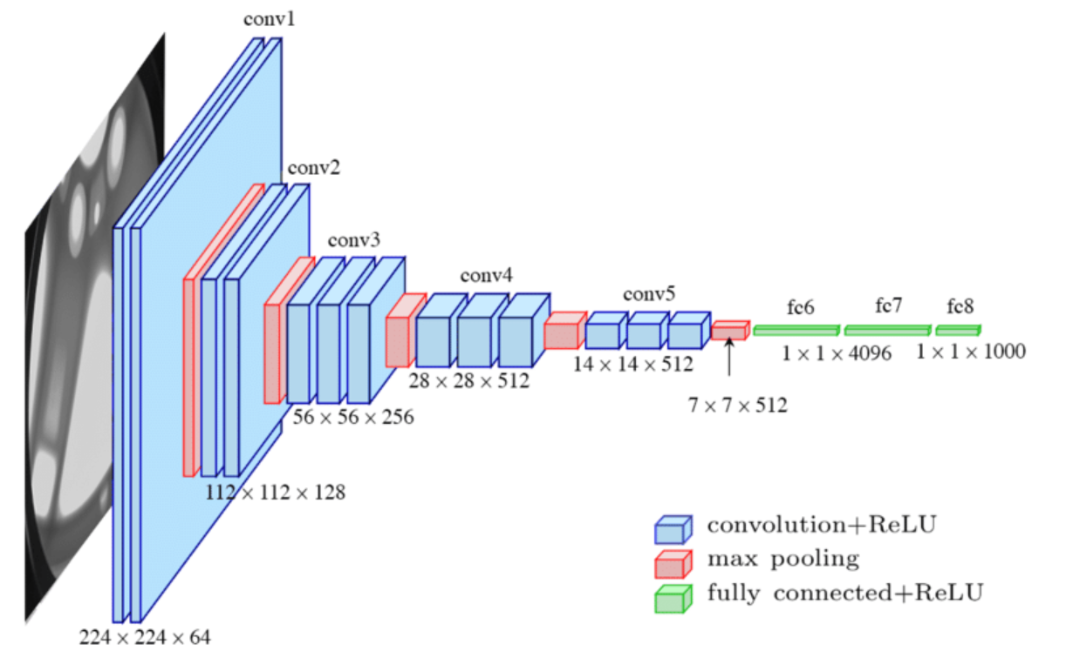

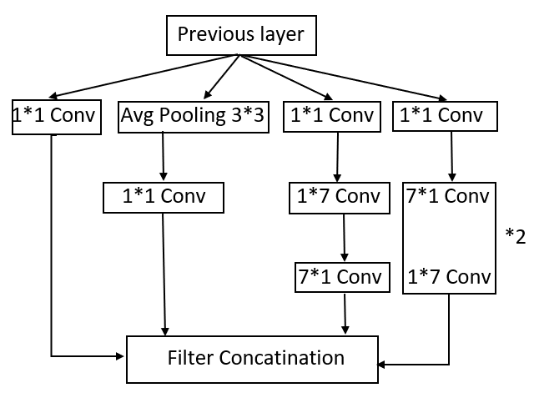
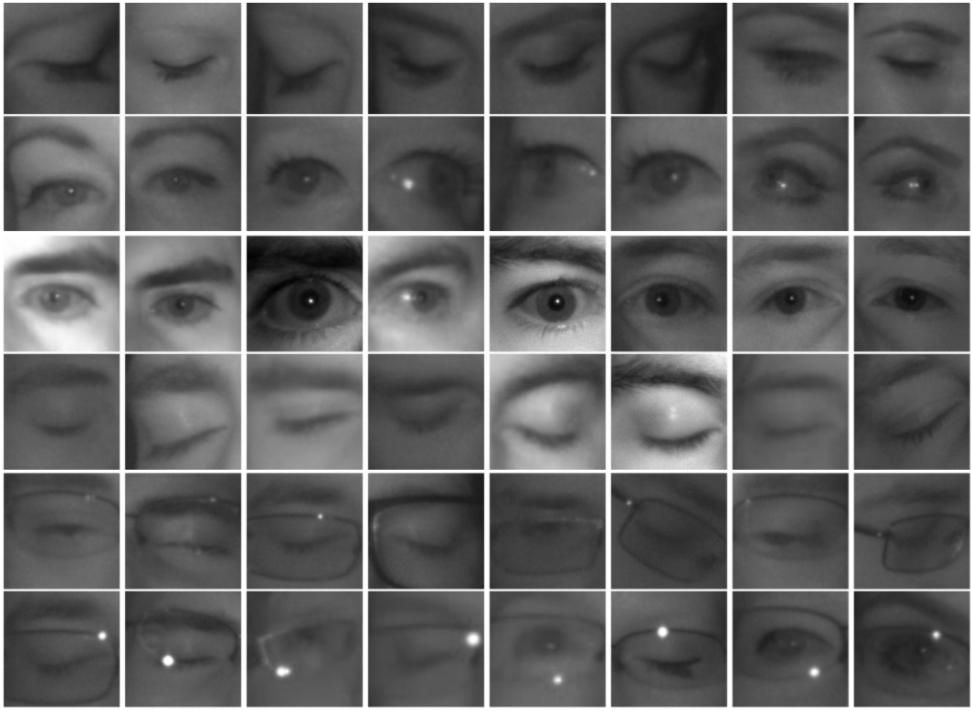
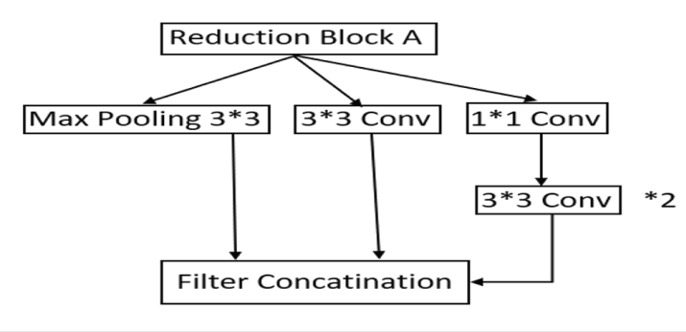
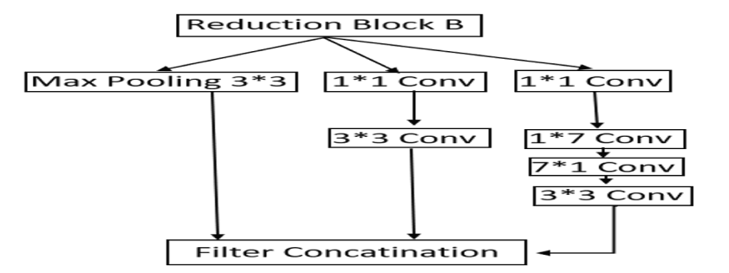
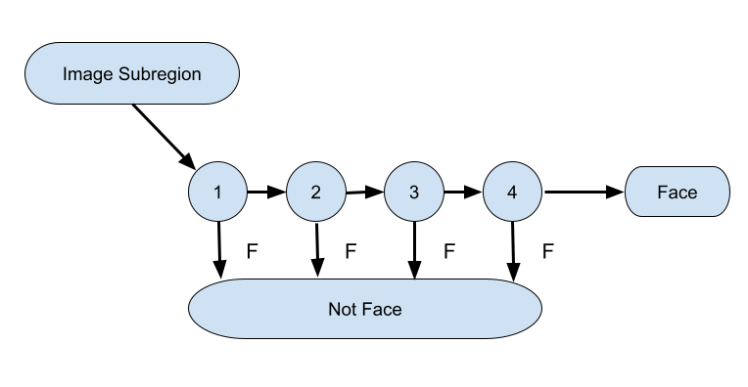

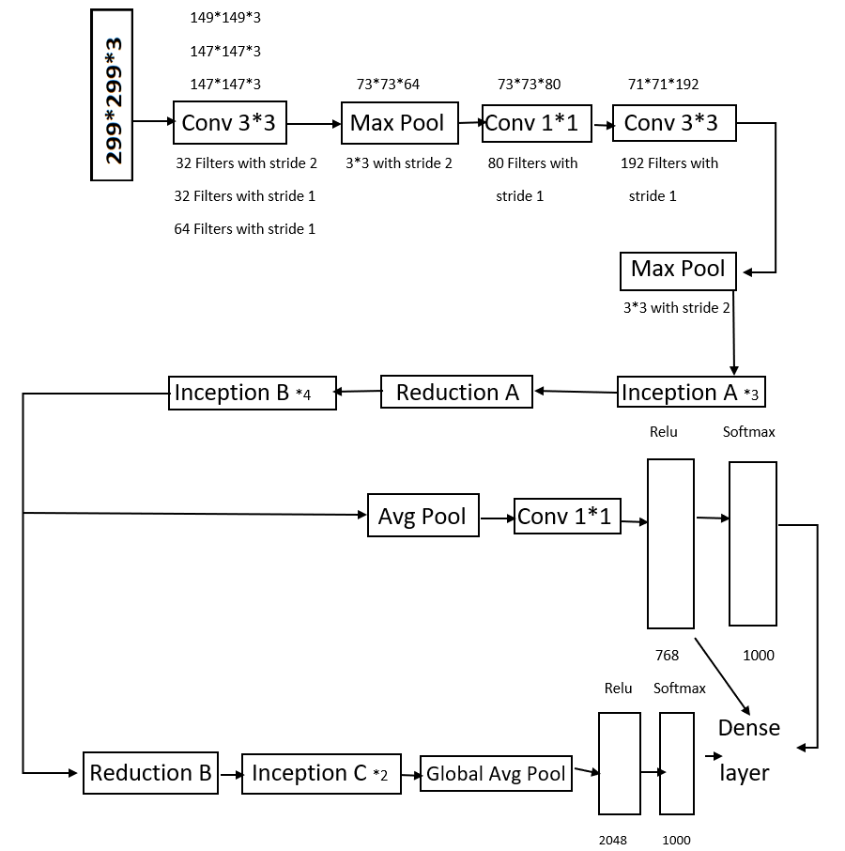
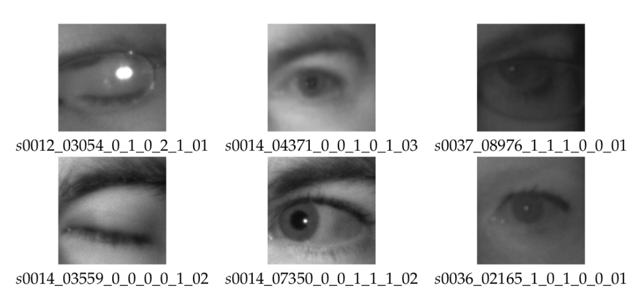
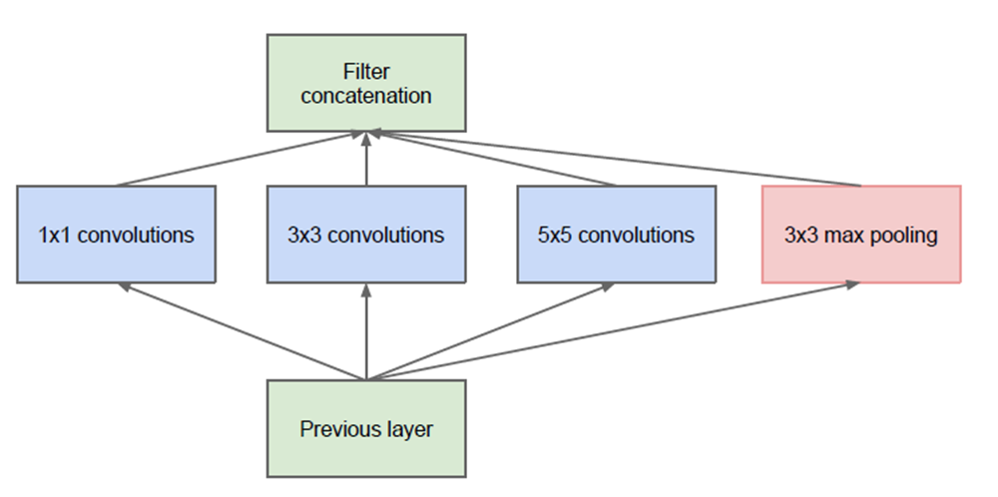
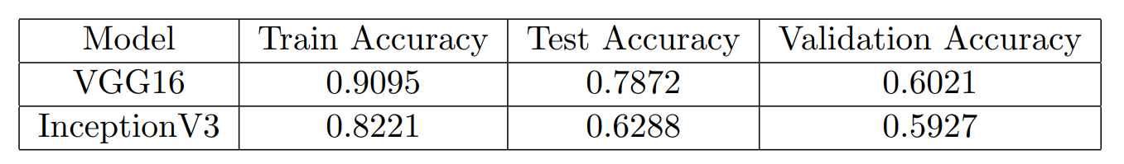
A Deep Learning Approach to Detect Drivers Drowsiness
Akshay Ghatage
Adviser – Prof. B. W. Gore (SCMS, SPPU)
Savitribai Phule Pune University
Introduction
Transfer Learning
Dimension Reduction of InceptionV1
Haar Cascading
The project focuses on the drowsiness of drivers.
Drowsiness is one of the major cause for the accidents.
The aim of this project is to develop a drowsiness detection system and reduce the number of drowsiness related accidents.
A system which can alert, when one feels drowsy.
Approaches are: VGG16 and InceptionV3
Haar Cascading Architecture.
VGG16 implementation.
VGG16 and Haar Cascading was the best implementation.
Transfer learning is a machine learning technique in which a network that has been trained to perform a specific task is being reused for another similar task.
Knowledge of an already trained machine learning model is applied to a different but related problem.
Transfer Learning with Image Data
Added a 1*1 convolutional layer before each convolutional layer.
The Voila Jones Algorithm is another name for Haar Cascading.
This technique of object detection is very fast and accurate.
It is used to identify faces and eyes in image or a real time video.
Haar Like Features
Object identification relies on computer vision attributes known as Haar-like features.
Positive Images – These images contain the image which we want our classifier to identify.
Negative Images – Images of everything else, which do not contain the object we want to detect.
Haar value calculation –
Pixel value = (Sum of the Dark pixels/Number of Dark pixels)
- (Sum of the Light pixels/Number of Light pixels)
2 Rectangle = A–2B + C–D + 2E–F
3 Rectangle = A–B–2C + 2D + 2E–2F–G + H
4 Rectangle = A–2B + C–2D + 4E–2F + H–2I + J
Inception Block-A
To make the better of dimension reduction, the larger convolutions factorized in smaller convolutions in inception Block-A.
Instead of 5*5 convolution in dimension reduction, here in inception block-A we are using 2
convolution layer which has the 3*3 convolution.
Which reduce the parameter by 28%
Project Overview
Integral Image
Inception Block-C
It is used to calculate the sum of pixel values in an image or a rectangular portion of an image in a quick and efficient manner.
By using integral image, we can achieve the Haar Features.
Model-VGG16
In Inception block-C, n*1 is the form of the asymmetric convolutions.
Here we replace 3*3 convolutions with 1*3 and 3*1 convolutions.
In this the number of parameters is reduced by 33%.
This is the one of the most preferred CNN architecture.
VGG16 is preferred as it has a very uniform architecture.
VGG16’s architectural simple and use of simple filters for convolutional operation.
After convolutional and fully connected layer, it used a rectified linear unit (ReLU) activation function.
It also uses regularization techniques like dropout and data augmentation to avoid over-fitting.
Inception Block-B
AdaBoost Learning
In Inception Block-B there is a average pooling layer, which is further reduced.
7*7 convolution layer is reduced into 1*7 and 7*1
Nearly 160,000 features are present in the 24*24 detector window, but only a few of these features are important for identifying a face.
As a result, we should be uses the AdaBoost technique to identify the best features among the 160,000 available.
Each Haar-like feature in the Viola-Jones algorithm represents a weak learner.
AdaBoost evaluates the performance of all classifiers supplied to it to find out the type and size of a feature that should be included in the final classifier.
Data Identification & Preparation
Cascade Filter
The MRL eye dataset, the large-scale dataset of human eye images.
This project is based on the MRL Eye Dataset. The dataset consists of 84,898 eye images of 37 subjects (33 men and 4 women).
Reduction Block-A & Reduction Block-B
We have a 24*24 window that we will slide over the input image to see if any of the regions contain the face.
The cascade’s job is to quickly discard non-faces in order to avoid wasting time and computations.
The extracted feature from the image is passed trough classifier and it predicts, if that image is consist of the given features, then it will passed to next classifier and if that image does not have this features then it will be discarded and next image is checked.
It allows to process videos at a rate of 15 frames per second approximately.
subject ID
image ID
gender [0 - man, 1 - woman]
glasses [0 - no, 1 – yes]
eye state [0 - closed, 1 – open]
reflections [0 - none, 1 - small, 2 – big]
lighting conditions [0 - bad, 1 - good]
Model-InceptionV3
The Final InceptionV3 Model
This model is made up of symmetric and asymmetric construction components.
It combine with the convolutions, average pooling, concatenations, dropouts, and fully connected layers.
ReLu and SoftMax activation functions is to be used.
In the InceptionV3 model there are 48 layers. Which is the higher than Inception V1 and V2 models. Efficiency of this inception model is very impressive.
InceptionV1
Model Evaluation
To overcome on the overfitting problem, the multiple deep layers are set to the parallelly.
According to scores of above table, VGG16 model has the better accuracy than InceptionV3.

